Slide 1
Distributed Database Systems Course - Group Project
Daniel Zhang-Li
2023380016

Slide 2
Motivation
To simulate the process of industry level data management and server
To get a practical grasp on DFS
To practice other skills such as docker and docker-compose?
To complete the course project

Slide 3
Methodology – Framework selection
Deployment
Dockerfile
Much more light-weighted then giving the environment or uploading a super large image
Docker-Compose
Why Docker-Compose instead of Docker?
Much more friendly to quickly launch or remove launches
Writing config file is much easier than writing long and boring `docker run` commands
No need to worry about the order of running or stopping and removing container and networks
Comparing to K8s, we don’t have actual multiple machines so docker-compose is enough.
Safety
Docker can create its own subnet any only open a few ports to interact with the outside world, making it much safer
DFS
DBMS

Slide 4
Methodology – Framework selection
Deployment
Dockerfile
Docker-Compose
DFS
FastDFS
Super easy to launch
I spend weeks for deploying Hadoop and discovered HDFS is really unstable
The commonly used image is outdated and insecure
Uses old version of log4j which potentially is unsafe
We can use FastDFS for fault tolerance by replicating file to different groups
Easier License
FastDFS is open-source and uses the GNU General Public License, which might be more appealing for certain open-source projects or for organizations looking to avoid more restrictive licensing.
MinIO uses the GNU Affero General Public License v3.0 for its open-source version, and a commercial license is available for enterprises needing commercial support or looking to integrate MinIO into proprietary software.
DBMS

Slide 5
Methodology – Framework selection
Deployment
Dockerfile
Docker-Compose
DFS
FastDFS
DBMS
MongoDB
JSON interaction
Sacrifice Space for Time
Default have cache, no need to configure
Good interface support for various cases

Slide 6
Methodology – Framework selection
Other Tools
Flask
Easy and quick support backend
We also use it for easy frontend
Supports python
Note: In higher throughput systems fastapi and springboot might be a better choice
Nginx
Quickly and easy yet effective routing(and a bunch of various applications) for network interactions

Slide 7
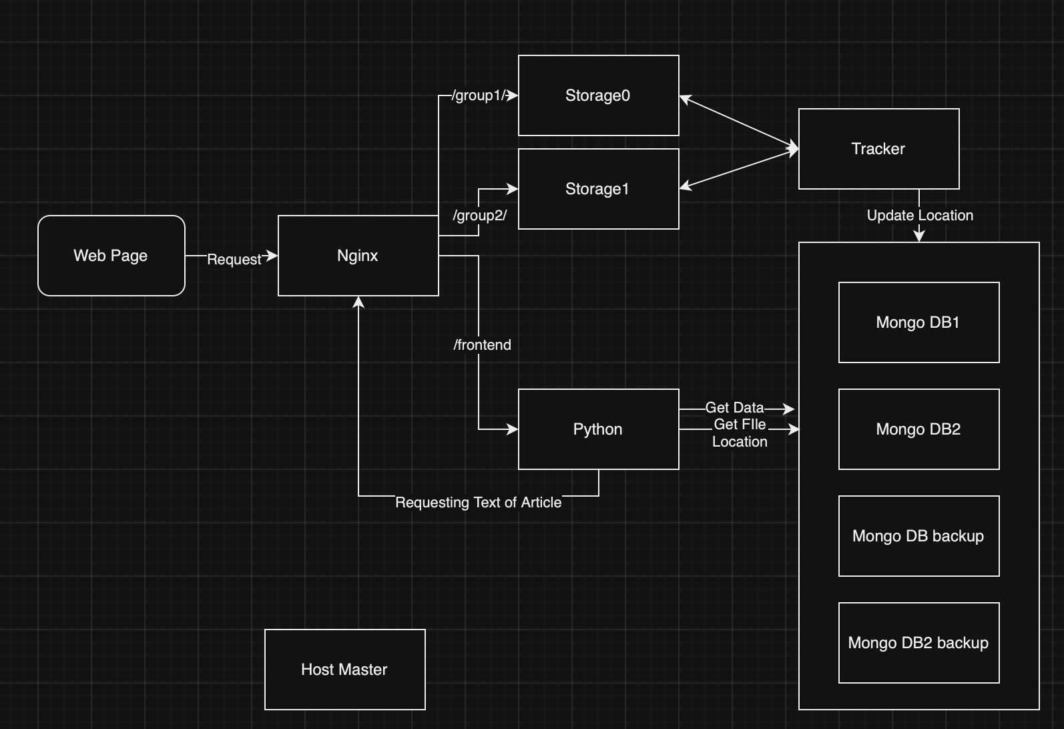
Framework
Overall Structure
More Nodes for FastDFS can be added

Slide 8
Start-Up Order
Docker Compose can start many containers at the same time, but we also have a few dependencies
For FastDFS
Storage0 and Storage1 Depends upon Tracker
For Others
Python should be started after all the Mongo containers
Not strictly needed, but just in-case
Nginx doesn’t need dependency since it only does routing in our case

Slide 9
Bulk Loading
Bulk Loading to MongoDB
MongoDB has its own mongoimport
This previously was needed to download the additional binaries, but for container versions it is already installed
Using Buffer to Load Data
We map directories to the mongo containers
docker-compose.yml
Write data to be loaded to such files
bulk_load_data.py
Use mongoimport to bulk load data into target collections
post_bulk_load_data.py
As the DFS containers need more time to start, the buffer file generation process by nature gives time for later services to start

Slide 10
Bulk Loading
Bulk Loading to FastDFS
FastDFS has the upload_file command for uploading files.
How to store file mapping
Loop over the files to upload the file
bulk_load_file.sh
Save the file → location obtained from the tracker
bulk_load_file.sh
Parse the mapping and bulk load it into mongo accordingly
update_file_path.py

Slide 11
Generating BeRead
Running with-in Python Container
As we are banning the master node to directly having network interaction with the containers, we need to put the generation process at a place with connection to the mongo containers and can operate with python
We use serialized operation to generate beread
Looping over the articles
To boost performance, create aid index for the tables before operation
Backend/generate_beread.py line 18-19
Directly inserting to mongo
Use upsert(update_one with upsert on) instead of insert_one
easier debugging
This kind of operation ensures at-most-once level fault tolerance for inserting the beread datas

Slide 12
Generating Popular Rank
Running with-in Python Container
Same as generating beread
We try another approach, aggregate in mongodb
MongoDB by nature supports aggregation
Kind of like hfds’s map-reduce and spark?
We use group, addField, and project to get the cumulative results
Note the fact that Mongo treats ISO time as week in year
To aggregate the correct results for week, I instead used the first day of the week to aggregate results
For details see code at backend/generate_popular_rank.py line 103-205
Also use upsert with similar reason to beread generation

Slide 13
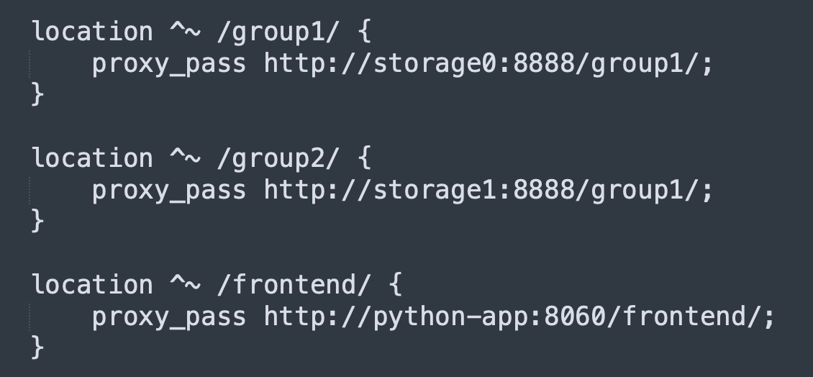
Nginx Configuration
We don’t need to change any settings for users and https, we only create a conf.d module with port 9090

Slide 14

Query and Demos
Single Table(Collection) access
Only access the article
http://localhost:9090/frontend/article/1012

Slide 15
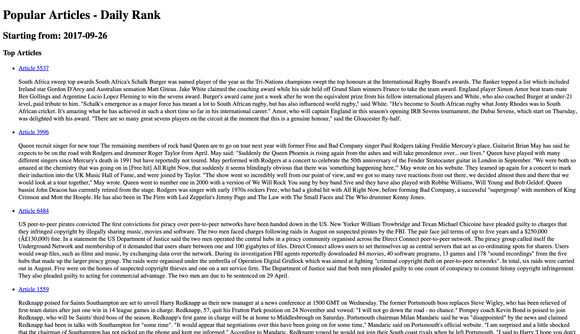
Query and Demos
Multiple Tables
http://localhost:9090/frontend/popular_rank/daily/1

Slide 16
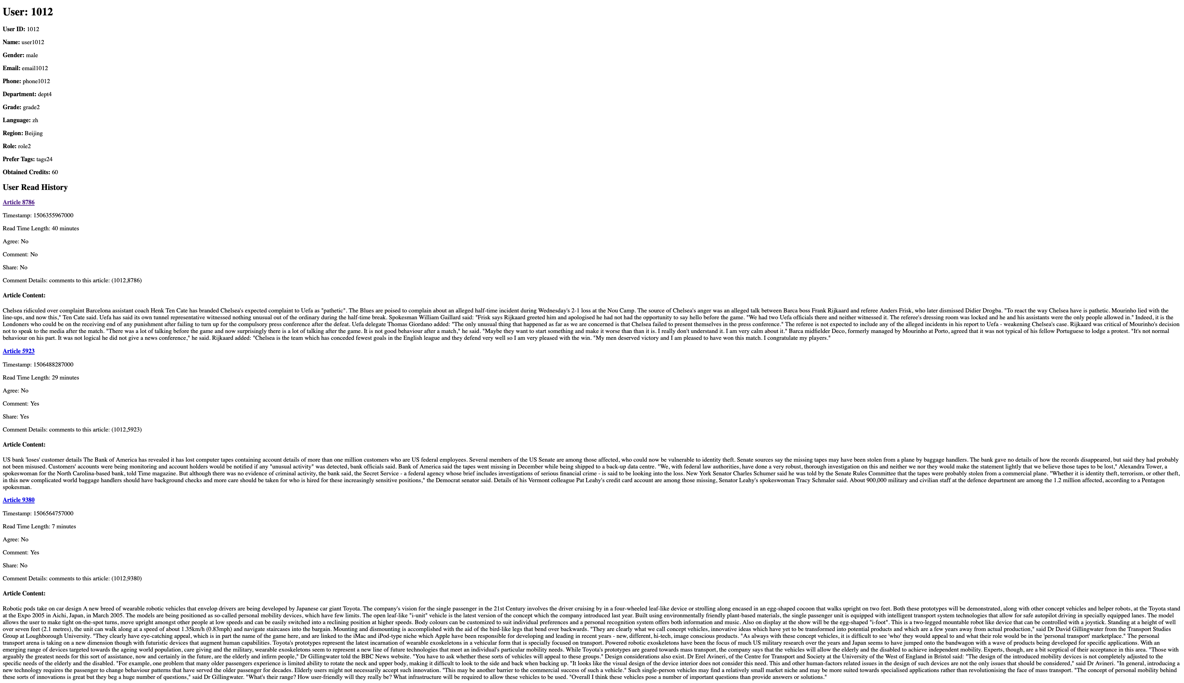
Query and Demos
Many Table
http://localhost:9090/frontend/user/1012

Slide 17
Fault Tolerance at DBMS level
During access, by designing, we ensure we try all the backup of the target db(db1 or db2) until one successfully returned
Dropping any data node will still allow the system to run
We supply backuping and restoring a database deployment in another deployment

Slide 18
Fault Tolerance at DBMS level
An example usage
clear_ddbs1.sh
Drop the DDBS1 deployment
The system is now served with DDBS1_BACKUP deployment
fuse_ddbs1_from_bak.sh
Since DDBS1 could now be viewed as a completely new deployment We fuse data from DDBS1_BACKUP deployment to the ddbs1 deployment
clear_ddbs1_bak.sh
Drop the DDBS1_BACKUP deployment
Now the system is served with only DDBS1
Restore_in_bak_ddbs1.sh
Restore DDBS1_BACKUP from dumped backup Now the system is served with both dbs

Slide 19
Monitoring
We expose ports of the mongo containers to use mongo-compass
In realworld, we can use the following ways to map the container to mongo-compoas
ssh
Port mapping
i.e. ssh –NL 27017:localhost:27017 [HOST and User Name]
Compass with SSH
A bit harder to configure than just using ssh port map
FRP
Advanced Port Mapping
Create a central server to moniting and map the 27017 ports to this machine

Slide 20
Reproduce Results
You only need one line
bash initialization.sh
Code
Publically Available at https://github.com/Danielznn16/DDBS-Final
Will be set to public after hw deadline

